Slide 1

CFSS Project: Wi-Fi Security
This project aims to analyze common Wi-Fi security standards, encryption techniques, and known vulnerabilities. It will explore the history of Wi-Fi encryption standards, identify common attacks and threats to Wi-Fi networks, and implement secure practices to defend against these threats.
by Ahetesham Mopagar
Cybersecurity Analyst Intern

Slide 2
Wi-Fi Standards: A Historical Overview
1
2
3
4
WEP (Wired Equivalent Privacy)
WPA (Wi-Fi Protected Access)
WPA2 (Wi-Fi Protected Access II)
WPA3 (Wi-Fi Protected Access III)
Introduced in 1997, WEP was one of the earliest encryption standards. It used 64-bit or 128-bit encryption keys, but its weak key generation method made it easily crackable. WEP is no longer considered secure and is deprecated.
WPA, introduced in 2003, improved upon WEP by using Temporal Key Integrity Protocol (TKIP) for encryption, which dynamically changes keys. While more secure than WEP, TKIP still has vulnerabilities and is less secure compared to modern standards.
Released in 2004, WPA2 became the industry standard for many years. It uses Advanced Encryption Standard (AES), which is much more secure than TKIP. WPA2-PSK (Pre-Shared Key) is for home networks, while WPA2-Enterprise adds additional authentication methods for enterprise environments.
Introduced in 2018, WPA3 addresses weaknesses in WPA2. It improves security with Simultaneous Authentication of Equals (SAE), providing stronger protection against brute-force attacks. WPA3-Personal uses SAE for home networks, while WPA3-Enterprise offers even more robust encryption for organizations.

Slide 3
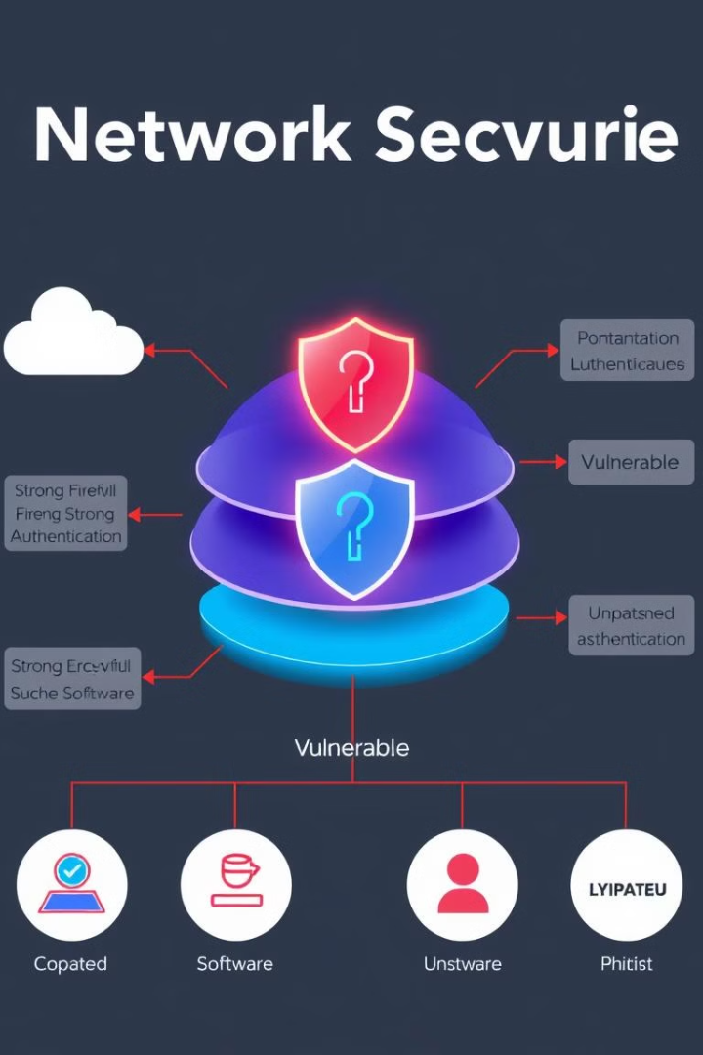
Key Components of Wi-Fi Security
1
Encryption
WPA2 uses AES encryption, which is considered much more secure than WEP's RC4. AES provides stronger protection against attacks that try to decipher the encrypted data.
2
Authentication
WPA2 with Pre-Shared Key (PSK) is commonly used for home networks, where users share a password to access the network. WPA2-Enterprise uses RADIUS authentication servers for more robust security in enterprise environments.
3
Security Flaws
Known vulnerabilities like KRACK (Key Reinstallation Attack) have been discovered in WPA2. WPA3 addresses these weaknesses with improved security features and protocols.

Slide 4
Wi-Fi Security Vulnerabilities
WEP Cracking
WPA/WPA2 PSK Cracking
KRACK Attack on WPA2
WEP can be cracked using tools like aircrack-ng. The weak initialization vector (IV) can be exploited to decipher the encryption key.
WPA2 PSK can be brute-forced using tools like hashcat. A WPA2 handshake can be captured using airmon-ng and airodump-ng, and dictionary attacks can be performed.
The KRACK attack exploits vulnerabilities in the WPA2 handshake. It can be simulated to understand how attackers can decrypt data even with strong passwords.

Slide 5

Defending Against Wi-Fi Attacks
Encryption
Use WPA3 if available, or WPA2 with AES encryption. Avoid using TKIP, which is weaker and more vulnerable to attacks.
Strong Passwords
Use long, complex passphrases to defend against brute-force attacks. Avoid using common words or easily guessable combinations.
Hidden SSID and MAC Filtering
While these methods can provide a small layer of security, they are easily bypassed and are not considered strong defenses.

Slide 6





Tools for Wi-Fi Security
Aircrack-ng
A suite of tools for Wi-Fi network auditing, including WEP/WPA cracking.
Hashcat
A powerful password-cracking tool used for WPA/WPA2 pre-shared key cracking.
Wireshark
Network protocol analyzer for monitoring and analyzing Wi-Fi traffic.
Kismet
A network detector and packet sniffer that helps discover rogue devices.

Slide 7
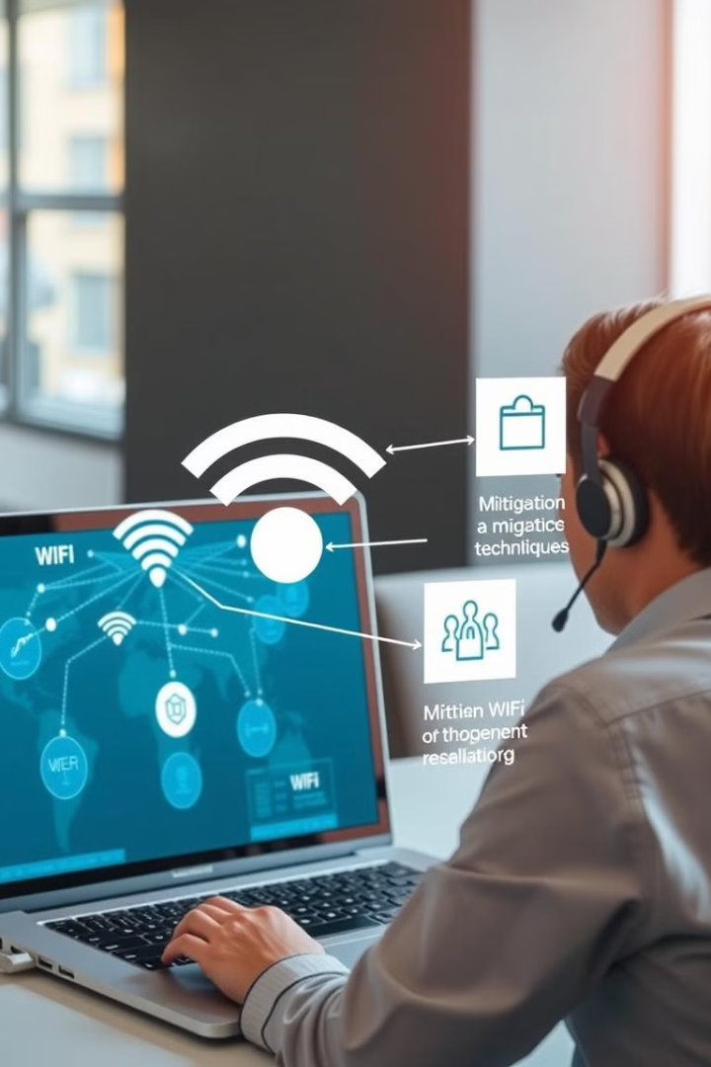




Mitigation Techniques
Network Segmentation
Separate guest Wi-Fi from critical infrastructure to limit the impact of a compromised network.
VPN over Wi-Fi
Use a VPN to encrypt traffic even if the Wi-Fi connection is compromised.
Regular Firmware Updates
Ensure routers and access points are always updated to patch known vulnerabilities.
802.1X Authentication
Explore advanced security mechanisms like 802.1X, which uses RADIUS authentication servers for Enterprise Wi-Fi networks.

Slide 8

Ethical Considerations
Always obtain permission before testing on any Wi-Fi network. Ensure you understand the legal implications of performing Wi-Fi penetration testing in your region. Use a controlled lab environment to simulate attacks and defenses. Consider setting up a home Wi-Fi network with a test router for this project.

